Slide 1

PlaatScrum (Raspberry Pi scrum tool) Open Source Project
W.B.J. van der Plaat
(Principal IT Architect)

Slide 2

Questions
How can I manage an offshore scrum team?

Slide 3


Idea
Lets create an light weight digital scrum tool with can run in my private “cloud“
Scrum tool can be controlled via HTML browser
Tool must run on low cost hardware, a Raspberry Pi.

Slide 4
PlaatScrum - Features
Web GUI to managed
Stories, Tasks, Epics, Bugs
Backlogs:
Product, Sprint, Personal based
Boards:
Task, Story, Status based
Charts:
Burndown, Velocity, Status, Calender
Manage
Projects, Releases , Sprints, Users with roles

Slide 5
PlaatScrum Software Architecture
Presentation Layer
HTML/CSS/JS
Apache
Business Logic Layer
PHP
Database Layer
MySQL
Operating
System
Debian Linux

Slide 6
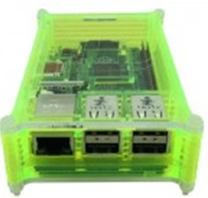

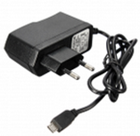
Used hardware
Raspberry Pi 3B
Raspberry Case
USB Power Supply
SD Card

Slide 7

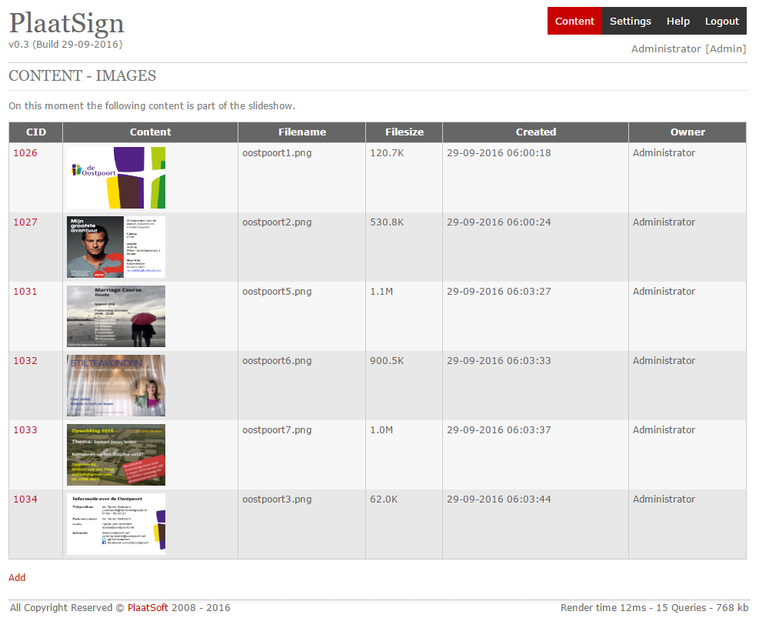
Hardware View – Configuration
Raspberry Pi
PlaatScrum
Ethernet
ADSL Router
Ethernet
Internet
Use PlaatScrum
via internet

Slide 8
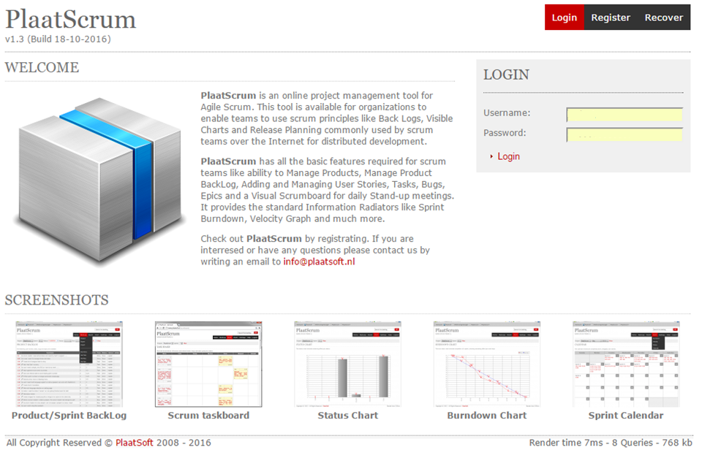
Screenshots

Slide 9
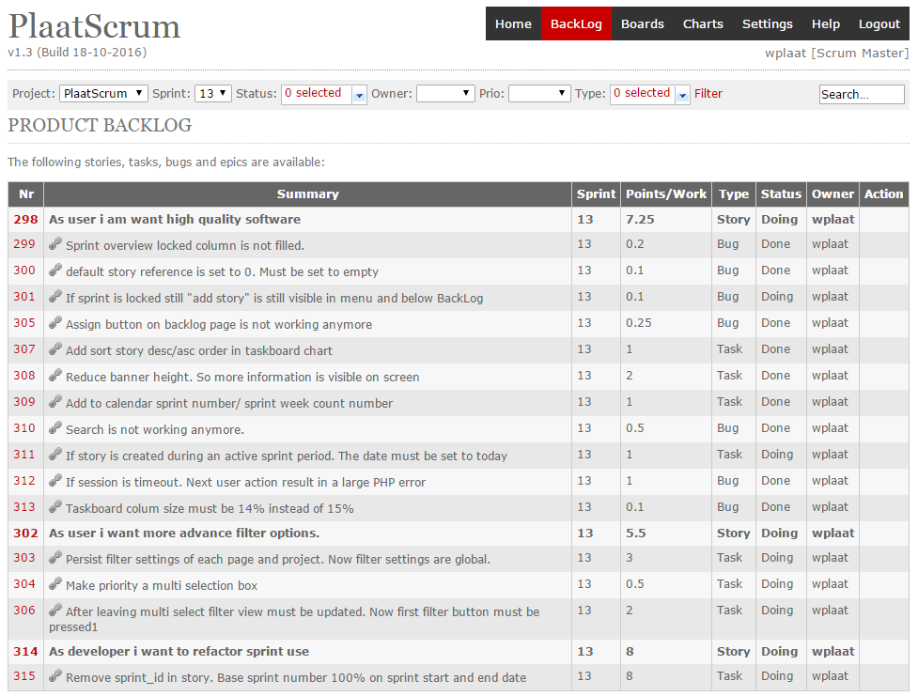

Slide 10
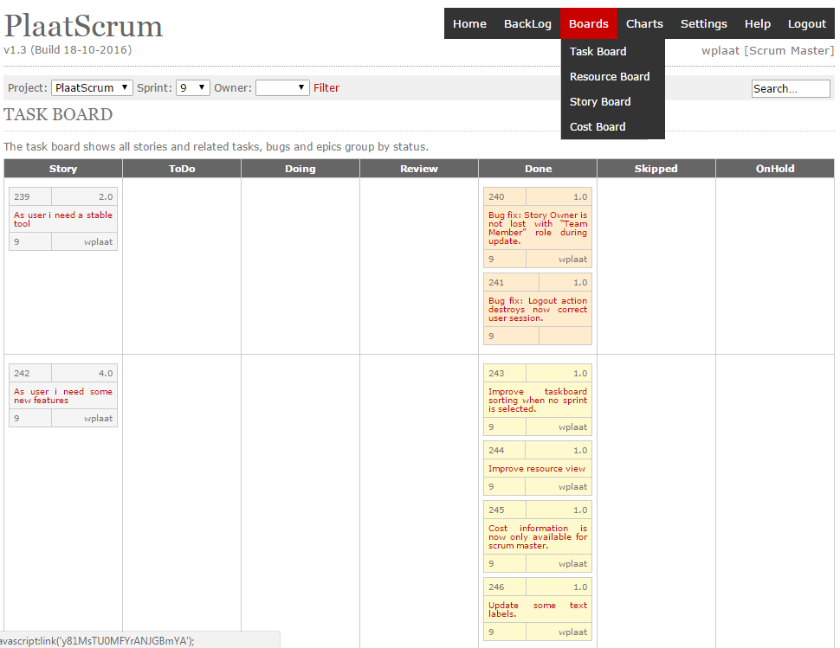

Slide 11
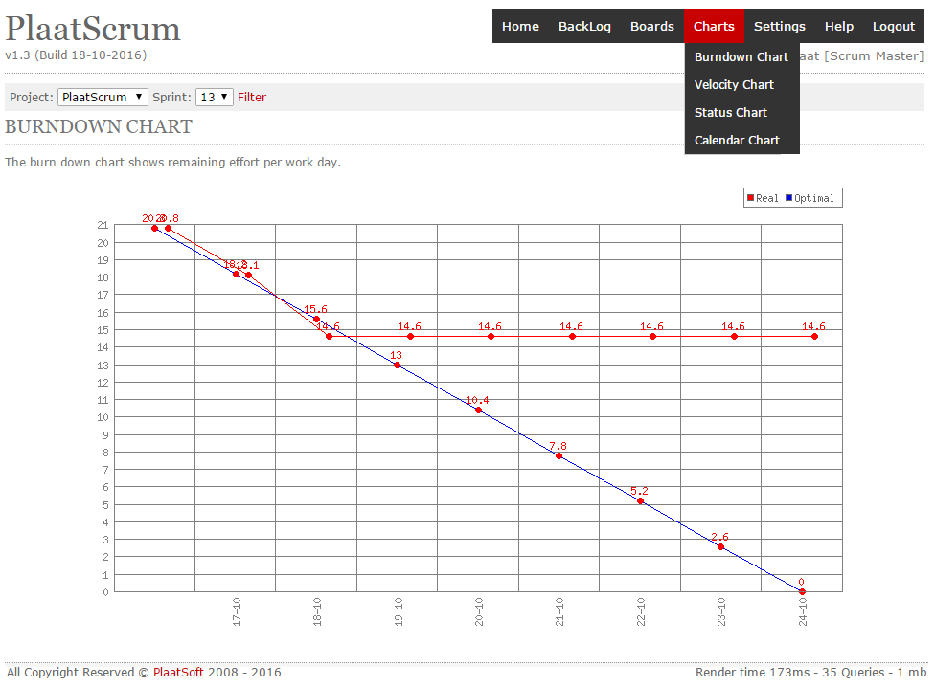

Slide 12
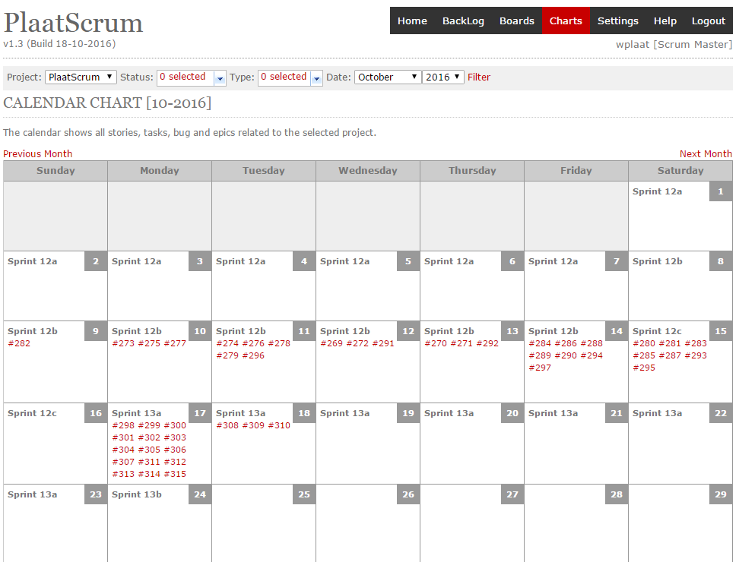

Slide 13
Conclusion
PlaatScrum offers a scrum tool to managed an offshore scrum team
Contain all basic scrum features
Easy to install and to maintain
It’s free to use!
It’s open source so easy to maintain

Slide 14

IR
Detector
More info
visit
plaatsoft.nl

